Slide 1
Thesis Defense
Chelsea (991547528)
Dec. 1, 2023

Slide 2
Overview
Outline of your talk
Typical structure would be:
Introduction
Motivation and Rationale
Thesis Statement or Research Question
Background
Methodology
Discussions
Results
4/ 8

Slide 3

What is Reinforcement Learning?
“Machine Learning Meets Decision - Making “

Slide 4
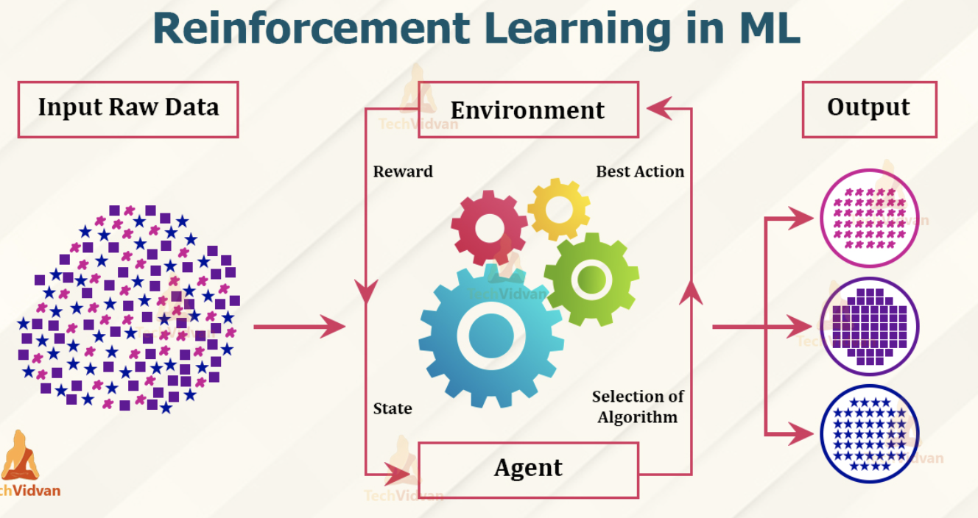
Core Concepts
Agent: The learner or decision-maker.
Environment: The external system or which the agent operates
Actions: The decisions that the agent can make,
Rewards: Positive or negative feedback that the agent receives
State: The current situation or condition of the environment
Policy: The set of rules that the agent follows

Slide 5
Motivation and Rationale
I wanted to explore the potential of Reinforcement Learning in the stock market trading domain. The stock market is highly complex, dynamic, and unpredictable, making it a challenging area to navigate. However, Reinforcement Learning has the potential to learn from the market data and adapt to the changing market conditions, making it a promising approach for stock market trading. By exploring this topic, I aimed to contribute to the development of more effective and efficient stock market trading strategies.
3/ 8

Slide 6
Thesis Statement
Our study focuses on using the FinRL framework to improve decision-making in the stock market by applying reinforcement learning. Specifically, the decision-making process involves determining whether to buy, sell, or hold a particular stock. To evaluate the effectiveness of reinforcement learning, we will compare it with other models based on the cumulative sum of profit or loss over a specific period of time. Our goal is to identify the ideal model configuration to support informed and strategic decision-making, which can contribute to the advancement of financial market analysis.
5/ 8

Slide 7
Relevant RL Applications in Finance
Algorithm Trading
RL models have demonstrated success in optimizing trading strategies, adapting to market conditions, and outperforming traditional algorithms.
Option Pricing
RL has shown promise in accurately pricing financial derivatives, especially in capturing non-linearities and complexities associated with options.
Market Making
RL algorithms are applied in market-making activities, enhancing liquidity provision and optimizing bid-ask spreads.
And many others….

Slide 8
Challenges and Gaps
Model Robustness
Interpretability
Adaptability
Data Quality
Computational Complexity

Slide 9
Transition to Thesis Statement
As we delve into the literature, we've navigated through the diverse applications of RL in finance, recognizing both successes and challenges. Our focus now narrows to explore the efficacy of RL, particularly the finding the best model including state variables, in predicting stock market outcomes. Let's uncover the journey from broad insights to the specific exploration of RL's impact on stock market dynamics.

Slide 10
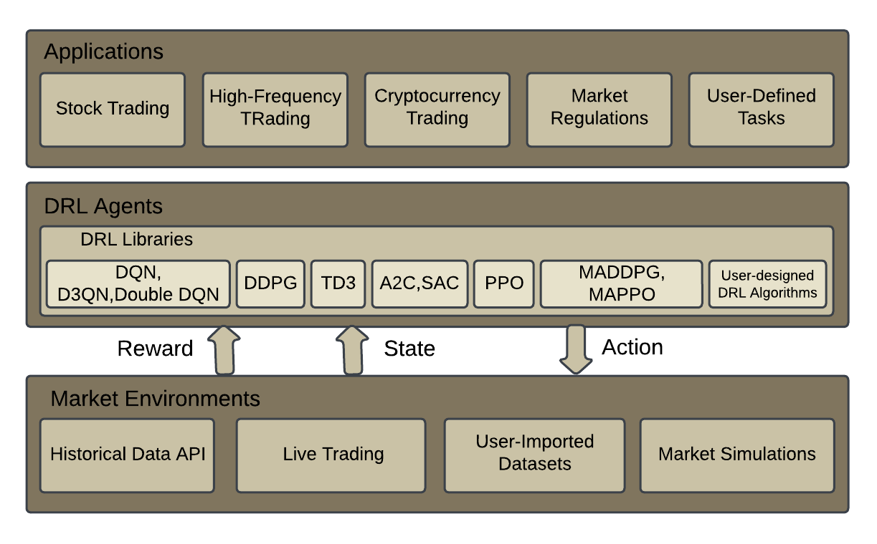
Methodology
Data Collection
Model Selection
Evaluation criteria
Data Preprocessing
State, Action, and reward definitions
Model Architecture and Hyperparameter Tuning
Experimental Design
Performance Metrics
FinRL Framework

Slide 11

Data Collection
Gathered Historical stock price and trading volume data from financial database from Yahoo Finance (YFinance)
Provide OHLC prices and volume data
Using Unified Data Processor to retrieve, clean and extract data feature.
Notes:
Yahoo finance- A comprehensive financial platform by Yahoo, offering real-time stock quotes, financial news, etc.
Data collection:This platform provides OHLC (Open, High, Low, Close) prices and volume, crucial for understanding stock market time series and making informed predictions.
Dow Jones 30 stocks: It consist of top 30 large and well known publicly traded companies.

Slide 12
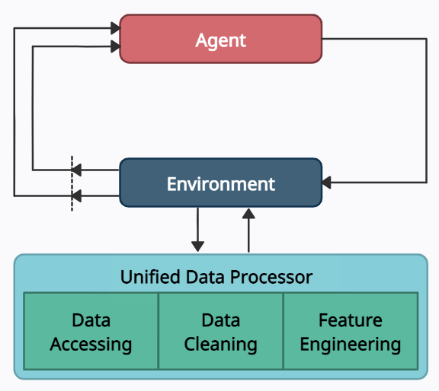
Implementation
Cleaning and Transforming Financial Data
Objective: Ensuring the quality and relevance of data from Yahoo Finance through cleaning and transformation processes.
Process: Using FinRL's Unified Data Processor to clean and extract crucial features, preparing the data for model training.
Training RL Agent on Historical Data
Objective: Enabling the RL agent to learn from historical market data and develop effective trading strategies.
Process: Leveraging the FinRL framework to train the agent on Dow Jones 30 stocks, incorporating various state variables and indicators for enhanced learning.
Notes:
Unified Data Processor (UDP): A tool provided by FinRL that interfaces with Yahoo Finance data. It plays a crucial role in retrieving, cleaning, and extracting relevant features from fragmented data, presenting a consolidated view for analysis.

Slide 13
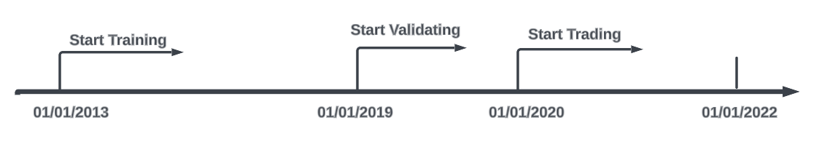
Data Preprocessing
Dataset Selection: Focusing on Dow Jones 30 stocks, using historical daily prices from January 1, 2013, to September 30, 2022, for training, validation, and trading stages.
Data Splitting: Dividing the dataset into training, validation, and trading data for a comprehensive evaluation.

Slide 14

Model Selection and Evaluation Criteria
Model Selection: Exploring and testing various DRL algorithms, which include A2C, DDPG, PPO, TD3, and SAC.
State Variables: Enhancing model performance by introducing state variables like OHLC prices, volume, technical indicators, and more.
Tuning Parameters: Adjusting hyperparameters such as learning rates, iterations, and exploration-exploitation ratios to optimize model performance.
Notes:
State variables: It represents the current situation and configuration of the environment that the learning agent is interacting with it. It contains all the relevant information which agent uses to make decisions and take actions in the environment.
Hyperparameter Tuning: They are the set of hyperparameter which collectively optimize the performance of the models.

Slide 15
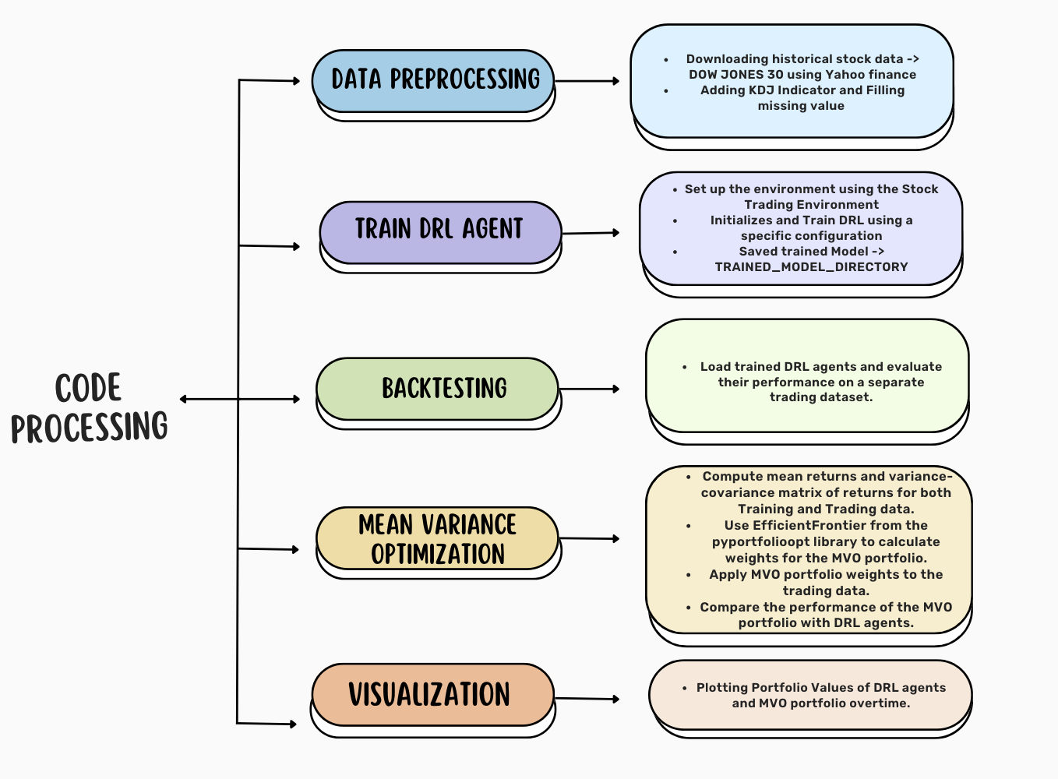
Introducing Our Methods and Discoveries Before Our Results

Slide 16
Portfolio Values
Portfolio Values = ∑ (number of shares_{i} X Closing Price_{i}
Measuring the financial performance of an investment portfolio is crucial in evaluating its effectiveness. This involves analyzing the performance of a range of assets held within the portfolio.
These values are calculated using the following:
Initial Portfolio: at the beginning of backtesting period, the initial value is set based on investment amount.
Action Execution: DRL agents actions for each stock are execute which involve adjusting the number of shares held for each stock based on agent decision.
Price Changes: The simulated market environment is updated to reflect the price changes of each stock over time.
Portfolio Revaluation: At each time step, the portfolio is revalued by multiplying the current number of shares for each stock by its corresponding price. The total portfolio value is the sum of the values of all individual stocks in the portfolio.
Notes:
Initial stock amount is 1000000

Slide 17
Mean Variance Optimization (MVO)
In 1950, Harry Markowitz developed a framework that helps to find the best allocation of assets in a portfolio to achieve the most favorable balance between expected return and risk. This approach is known as Modern Portfolio Theory (MPT) and is widely used in finance for portfolio optimization and reason is as follows:
Optimal Allocation
Risk Return Trade-off
Diversification Benefits
Widely Accepted

Slide 18
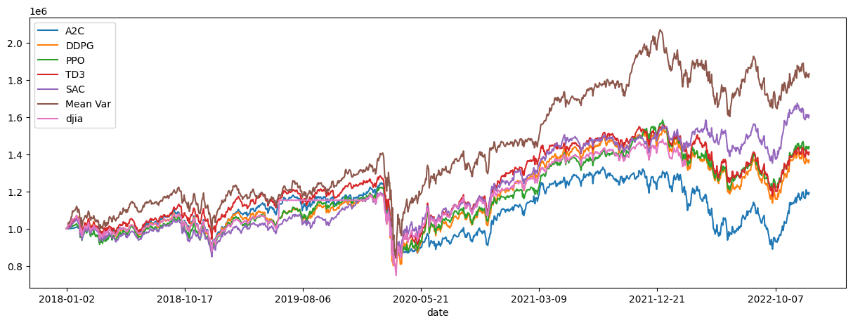
FinRL Results
Notes:
DJIA: it is Dow Jones Industrial average which is one of the most widely recognized in stock market and plays the role of barometer in the stock market.

Slide 19

Results
The success of the thesis relies on two evaluations: state variable and hyperparameter evaluations, in order to determine the best model for implementing in the stock market.
Case 1: adding the KDJ Indicator
Case 2: Random hyperparameter values
Case 3: Hyperparameter values with highest limits
Case 4: Model Performance Evaluation Based on different Metrics

Slide 20
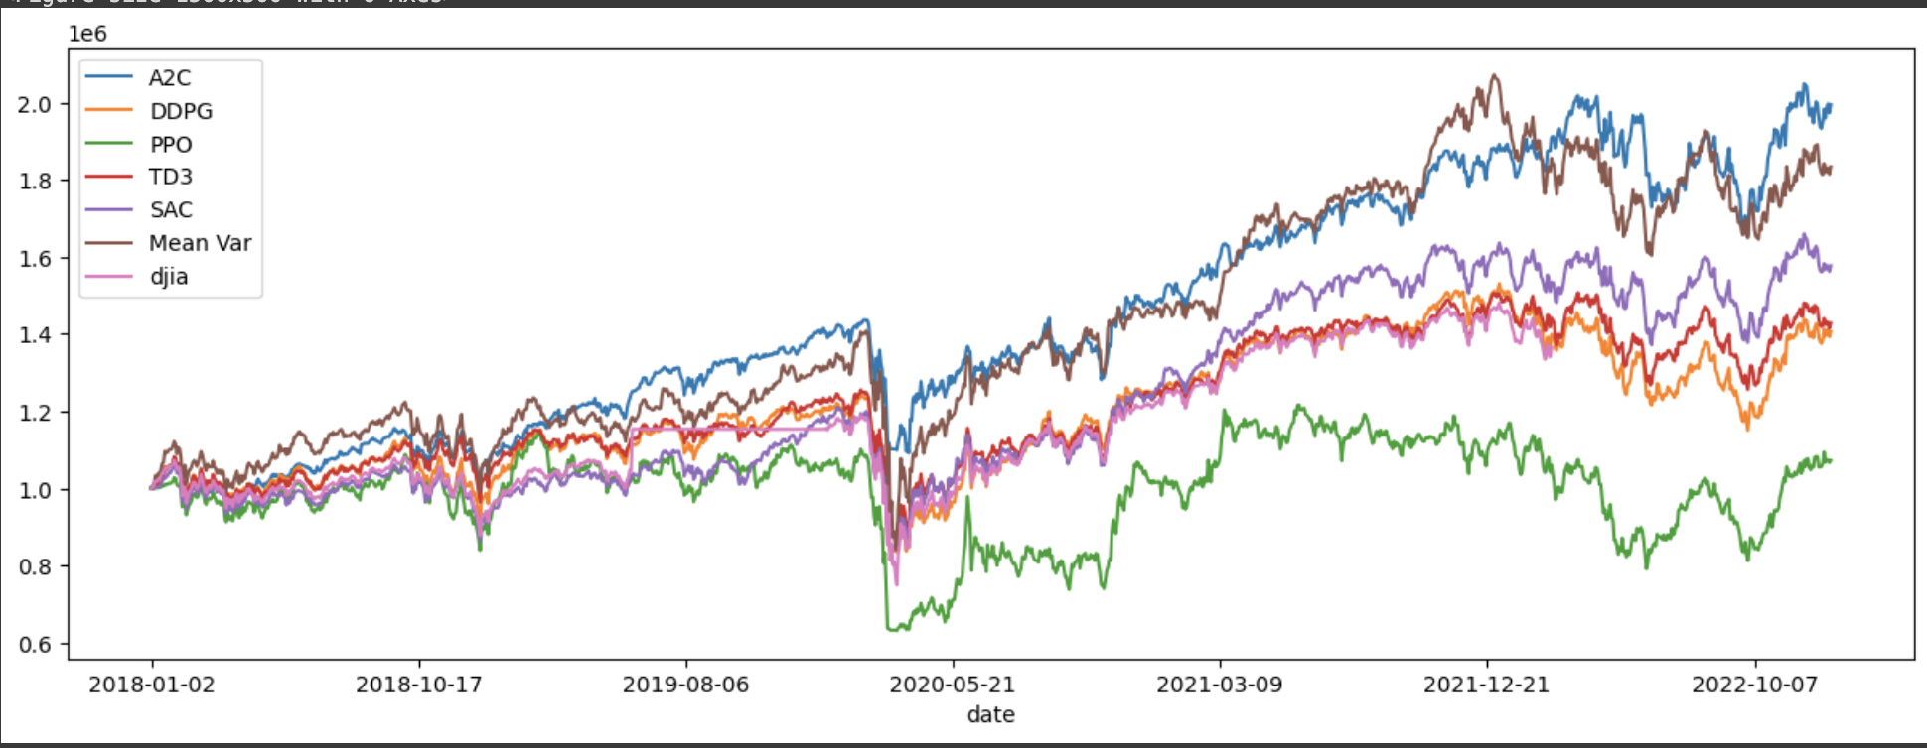
KDJ Indicator
Portfolio Values | A2C | DDPG | PPO | TD3 | SAC | Mean Var | DJIA
Case1 | 1.345827e+06 | 1.426518e+06 | 1.2429422e+06 | 1.483819e+06 | 1.649827e+06 | 1.834839e+01 | NaN
Notes:
Adding the KDJ indicator even though we have all other indicators in the data because it deals with Overbought and oversold conditions, in addition to that it deals with the volatility measurement which helps us to measure the risk managements.

Slide 21
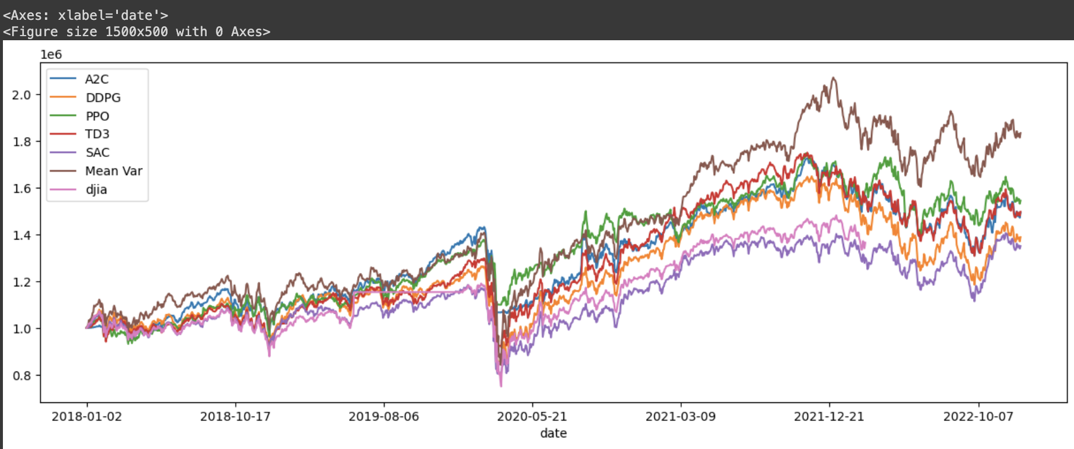
Random Hyperparameter Values
Portfolio Values | A2C | DDPG | PPO | TD3 | SAC | Mean Var | DJIA
Case2 | 1.493263e+06 | 1.389026 e+06 | 1.545319e+06 | 1.497823e+06 | 1.350727e+06 | 1.834851e+06 | NaN
Notes:
Working with different hyperparameter tuning and hyperparameter values help us to train the models in different conditions which helps us to know which parameters conditions would be ideal to train the model.

Slide 22
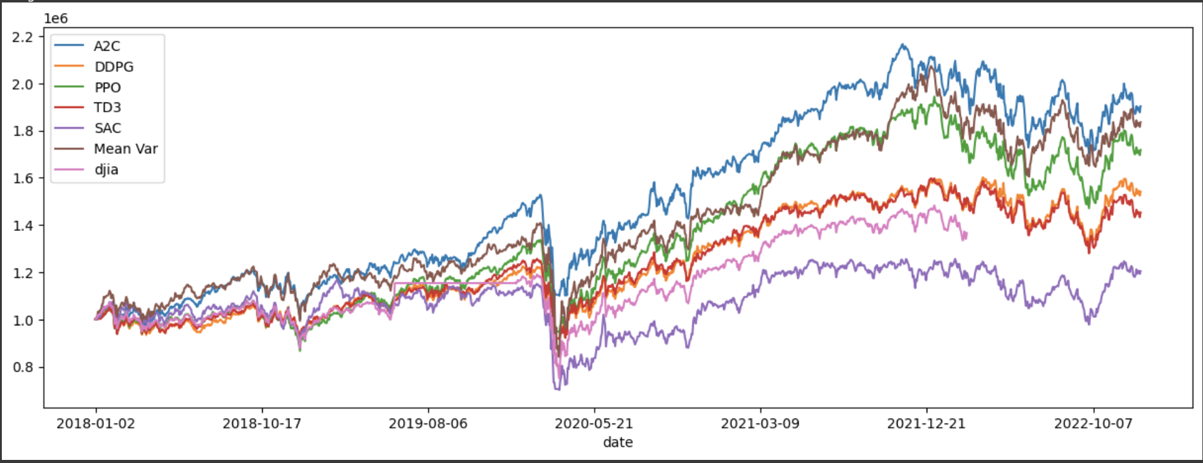
Highest Hyperparameter Values
Portfolio Values | A2C | DDPG | PPO | TD3 | SAC | Mean Var | DJIA
Case3 | 1.554598e+06 | 1.691702e+06 | 1.208365e+06 | 1.3108365e+06 | 1.535027e+06 | 1.834851e+06 | NaN
Notes:
In the above graph it is seen that keeping the hyperparameter values as follows:
1. n steps = 2048
2. entropy coefficient = 0.01
3. learning rate = 0.001
4. buffer size = 1000000
5. batch size = 256
6. learning start = 100
Would result into better evaluation for the models

Slide 23
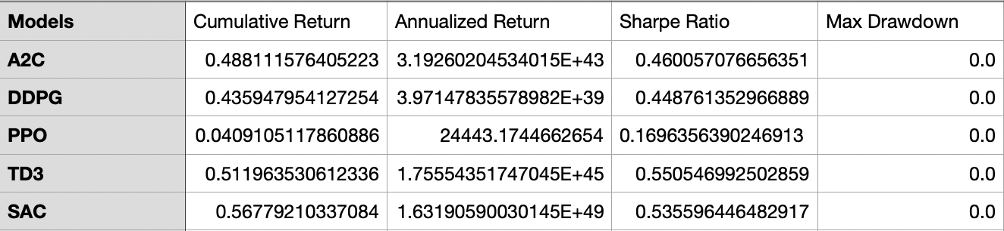
Evaluation Metric Table
The table below display the values of different performance metrics which helps us to identify the model that could provide the best results.
Notes:
Performance metrics are numerical measures used to evaluate the effectiveness, efficiency, and success of an investment strategy, portfolio, or trading algorithm in finance and trading. These metrics provide important information to investors and analysts, helping them understand the performance of their investments and make informed decisions. The results are obtained using the KDJ indicator + highest hyperparameter values and adding evaluation metrics which are cumulative return:A higher percentage indicates better performance. annualized return:Extremely high values may indicate potential issues or anomalies sharpe ratio: The higher the value implies better risk-adjusted return. max drawdown: maximum loss from a peak to a trough of an investment before a new peak is attained

Slide 24
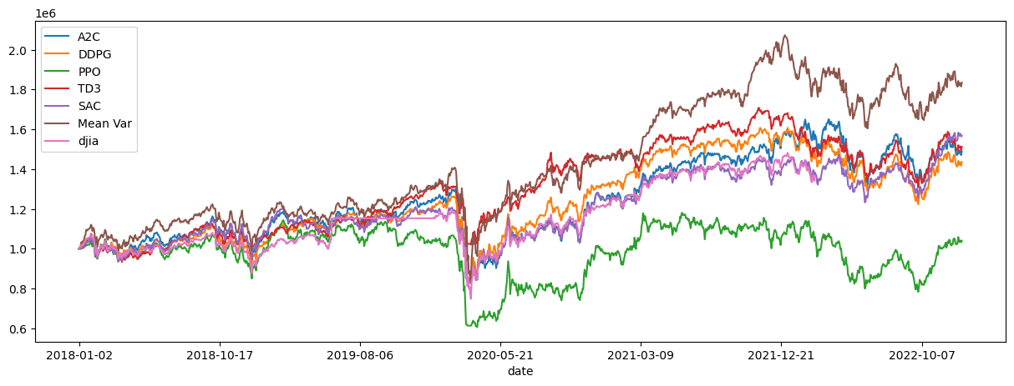
Model Performance Evaluation Based on different Metrics

Slide 25
Challenges and Limitations
Market Uncertainty
Predicting and adapting to unforeseen market shifts.
Developing strategies that are robust in the face of uncertainty.
Managing risks associated with sudden market fluctuations.
Data Noise
Identifying and filtering out irrelevant data points.
Ensuring data quality and accuracy in financial models.
Developing algorithms that can distinguish signal from noise in real-time data streams.
Notes:
Explanation: Financial markets are inherently volatile and subject to various external factors that can lead to sudden changes. These changes can be influenced by geopolitical events, economic indicators, or unexpected global situations.
Explanation: Financial data can be noisy, containing irrelevant or misleading information that can impact the accuracy of analysis and decision-making.

Slide 26
Future Directions
There are different directions in which we can go such as:
Exploration-Exploitation Strategies
Dynamic adjustments to the exploration rate or incorporating Bayesian optimization methods can enhance learning efficiency.
Feature Engineering
Explore additional technical indicators, market sentiment analysis, or alternative data sources to provide a more comprehensive view of market conditions.
And many more..

Slide 27
Key Takeaways
The research underscores the effectiveness of reinforcement learning models, particularly the Actor-2-Critic (A2C) model, in predicting stock market outcomes. The integration of the Stochastic Oscillator (KDJ) indicator further enhances the A2C model's performance, showcasing its potential for robust financial decision-making. The model's superiority, demonstrated with hyperparameter values near their upper limits, positions it as a valuable tool for accurate stock market predictions.

Slide 28
How this Thesis Advances the Field
The success of the A2C model, particularly with the inclusion of the KDJ indicator, emphasizes its practical applicability and sets the stage for future advancements at the intersection of artificial intelligence and financial markets. This research stands as a testament to the current state of knowledge while providing a solid foundation for ongoing exploration in this exciting field.

Slide 29
References
Xiao-Yang Liu, Zhuoran Xiong, Shan Zhong, Hongyang Yang, & Anwar Walid. (2022). Practical Deep Reinforcement Learning Approach for Stock Trading.
Liu, X., Xia, Z., Rui, J., Gao, J., Yang, H., Zhu, M., Wang, C. D., Wang, Z., & Guo, J. (2022). FINRL-META: Market Environments and Benchmarks for Data-Driven Financial Reinforcement Learning. arXiv (Cornell University). https://doi.org/10.48550/arxiv.2211.03107
Team, T., Team, T., Team, T., & Team, T. (2021, June 26). Reinforcement learning algorithms and applications. TechVidvan. https://techvidvan.com/tutorials/reinforcement-learning/
Huang, G., Zhou, X., & Song, Q. (2020). Deep reinforcement learning for portfolio management. ResearchGate. https://www.researchgate.net/publication/347965298_Deep_reinforcement_learning_for_portfolio_management
Bhadauriya, R. (2022, January 5). MACHINE LEARNING INTRODUCTION - ROHIT BHADAURIYA - Medium. Medium. https://medium.com/@creatrohit9/machine-learning-introduction-5049601d2da2

Slide 30


